Slide 1

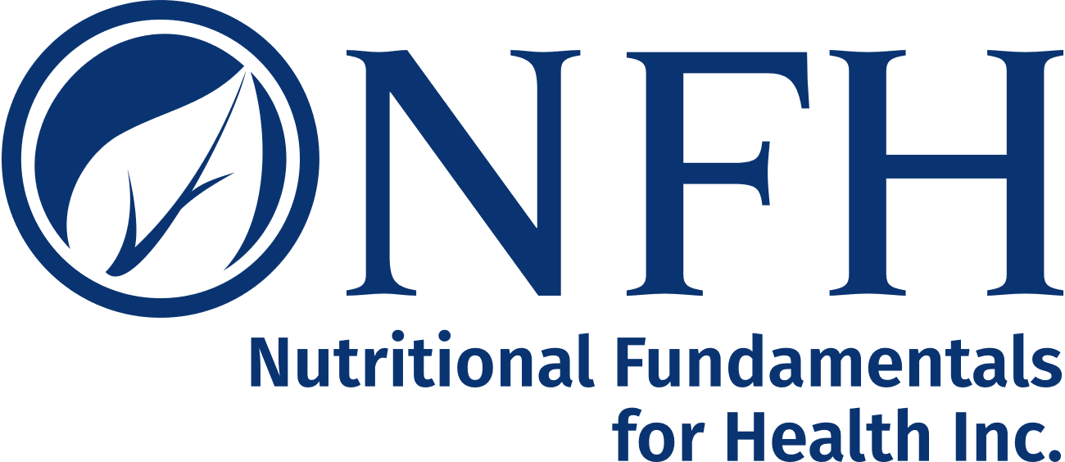
Fertility Optimization for Females and Males
Paving the Path to Optimal Health
Presented By
Dr Tori Hudson, ND
Clinical Professor, NUNM/Bastyr U/SCNM/CCNM
Medical Director, A Woman’s Time
Program Director, Institute of Women’s Health and Integrative Medicine
Education/Research Director, Vitanica
Faculty: AIHM

Slide 2

Disclosures
Scientific Advisory Boards
  Nutritional Fundamentals for Health Inc
  Gaia Pro Herbs
  Integrative Therapeutics Inc
  Symphony
Speaker’s Bureaus
  Doctor’s Data
Co-Owner
Vitanica: Director Education/Research
The statements and opinions presented in these slides have not been evaluated by the Food and Drug Administration. These products are not intended to diagnose, treat, cure or prevent disease

Slide 3
Health of our Offspring
Current generation being born is the first in history that is not predicted to have a longer lifespan than their parents

Slide 4
Contributors to Reduced Quality of Gametes
Age
Inflammation
Toxins
Smoking
Recreational/ prescription drugs
Hormonal imbalances
Sedentary lifestyle
Poor diet

Slide 5
Things to Consider for
Oocyte Quality
As women age there are several contributors that can have a negative impact on egg quality
  Decrease in serum androgens
  Increased oxidative damage
  Increased mitochondrial stress
  Microbiome

Slide 6
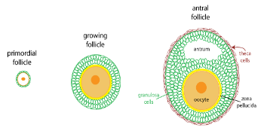
Mitochondria in the Oocyte
The embryo derives all of its mitochondria from the oocyte
As the cell grows, the number of mitochondria increases, reaching a peak at ovulation from 6000 mitochondria to 300-400K
These will be the only mitochondria present in the embryo until after implantation (Meldrum et al, 2016)
Image sourced from https://courses.washington.edu/conj/bess/female/female.html

Slide 7
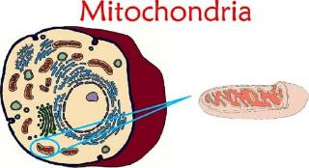
Mitochondria
The mitochondria will spread out through the rapidly dividing cells of the newly forming embryo
If healthy levels of mitochondria are present this will lead to optimal ATP production and better quality embryos (Benkhalifa et al, 2014)

Slide 8
Mitochondria
Why are mitochondria important?
  Mitochondrial DNA is more susceptible to mutation
    10-20 fold higher rate then nuclear DNA
  Mitochondria have a more difficult time undergoing repair
  As women age they are constantly exposed to low levels of free radicals and have reduced mitochondrial function leading to less ATP production

Slide 9
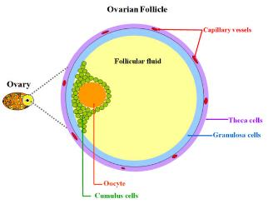
How can we Impact Oocyte Quality
Improve hormonal balance
Optimize the environment the oocyte grows in:
  Reducing free radicals
  Nourishing mitochondria
  Improve pelvic blood flow
Image sourced from: https://www.researchgate.net/figure/51648372_fig1_Schematic-picture-of-an-ovarian-antral-follicle-in-mono-ovulant-species-cells-are

Slide 10
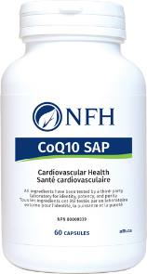
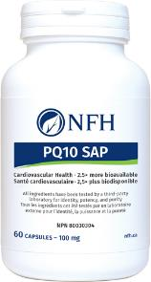
CoQ10
Benefits of coenzyme Q10:
  Antioxidant that scavenges free radicals
  Prevents oxidation of lipids and proteins in cells
  Supporting cellular energy production
Trial of 40 women diagnosed with PCOS
100 mg per day of CoQ10 for 12 week
Improved gene expression related to insulin, lipid metabolism and inflammation. (Rahmani E et al, 2017)
60 mg/day of CoQ10- 51 patients for 82 ovulation cycles
CoQ10 worked synergistically with clomiphene citrate in improving ovulation and clinical pregnancy rates, as opposed to clomiphene citrate alone.(Refaeey A et al, 2014)
Women diagnosed with poor ovarian response (under age 35) given 200mg tid for 60 days before IVF saw more embryos survive to day 3 (8% in treatment group had no day embryos and 22% in placebo group) (Xu et al 2018)

Slide 11
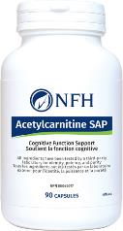
Acetyl-l-Carnitine
Benefits of Acetyl-L-carnitine
  Known antioxidant-protective effects on growing
  embryos (Gulcin 2006)
  Transports long-chain fatty acids across the inner mitochondrial membrane
  Reverses the age associated decline of mitochondrial membrane potential and improves mitochondrial abnormalities (Ames and Liu, 2004; Kathirvel E et al, 2013)
  Added to embryo cultures challenged by oxidative stress,
    reduced DNA damage
    improvement in chromosomal structure and development of blastocysts (Abdelrazik H et al, 2009)

Slide 12
Acetyl-l-carnitine and PCOS
A study of 27 non-obese PCOS women found significantly low levels of L-carnitine and sex hormone binding globulin (SHBG) in PCOS patients compared to healthy women
Low levels of L-carnitine were associated with hyperandrogenism and insulin resistance in PCOS patients (Fenkci et al, 2008)
RCT, 85 clomiphene-resistant PCOS patients got 3 g of L-carnitine in addition to 250 mg clomiphene citrate showed improved:
    ovulation
    pregnancy rates
    body mass index
    lipid profile
Compared to their counterparts who received only clomiphene citrate (Ismail et al, 2014)

Slide 13
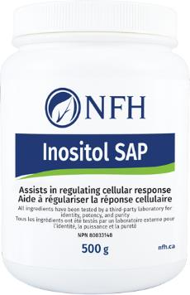
Myo-Inositol
In the ovary inositol:
    Aids glucose uptake in cells- energy status
    Improves FSH signaling which allows for better germ cell maturation (Facchine F et al, 2015)
In PCOS:
    Restores regular ovulation & ovarian function (LH, FSH, E2)
    Decreases serum testosterone
    Improves insulin sensitivity
    Decreases risk of OHSS
Improved oocyte quality was observed in 175 IVF participants with PCOS who were supplemented 4 g per day of myo-inositol from day 1 of cycle to 14 days after embryo transfer.
Pregnancy rates in myo-inositol and myo-inositol with melatonin supplemented groups were 36.7% and 41.4% respectively, compared to the controls without myo-inositol where pregnancy rate was 31% (Pacchiarotti et al, 2016)
12 weeks with 2 g per day of myo-inositol in 50 overweight PCOS patients reduced hyperinsulinemia, improved insulin sensitivity and restored balance in the levels of luteinizing hormone, prolactin, and testosterone (Artini PG et al, 2013)

Slide 14
Myo-inositol and Oocyte Quality
Research in non-PCOS patients:
  Concentration of myo-inositol in follicle correlates with improved oocyte quality (Chiu et al, 2002)
  Plays an important role in oocyte maturation
  May play a role in implantation
  Reduces the amount of gonadotropins medications required to stimulate the ovaries (during IVF) – leads to higher pregnancy rates (Pal et al, 2008)

Slide 15
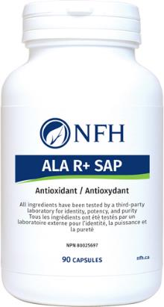
R-alpha lipoic acid (R-ALA)
  Lipid soluble antioxidant
  Improves glucose uptake via AMPK - likely how it helps endocrine and metabolic disorders
  400 mg ALA over 12 weeks in patients with PCOS and obesity found improvement in metabolic parameters such as body mass index and insulin (Genazzani et al, 2017)
  ALA in conjunction with myo-inositol in 36 obese PCOS patients improved metabolic parameters and oocyte quality after 3 months (Rago et al, 2015)

Slide 16
Vitamin E (mixed tocopherols)
Fat soluble antioxidant
Vit E for women >35 years of age
    improvement in the time to pregnancy for infertile couples over a range of doses (average of 37mg per day) from the time to conception up to live birth (Rudder et al, 2014)
Vitamin E has been associated with the number and size of eggs increasing with higher antioxidant supplementation in animal models (Barium Oz et al, 2016)
Vitamin E has also been shown to improve thin endometrium and high radial artery-resistance index of uRA at 600mg/day (Takasaki et al, 2014)

Slide 17
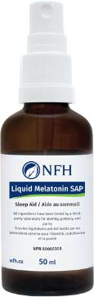
Melatonin
Works as a reproductive antioxidant
Concentrates in follicular fluid
Regulates circadian rhythm
Production decreases with aging
4 human clinical trials with melatonin and IVF/ICSI
  Statistically significant increase in number of mature oocytes and high quality embryos
Several studies look at the combination of myo-inositol and melatonin with added benefit seen (Seko et al, 2014)

Slide 18
Melatonin
Important to educate about natural ways to improve melatonin secretion
    Minimize blue light from devices
    Consistent bedtime/wake time
    Completely dark sleep space

Slide 19
Sperm Health
Count (total number of sperm)
Motility (how well the sperm can swim)
Morphology (how they look - do they have 1 head and 1 tail)
pH (how acidic or alkaline)
Total volume of fluid
Agglutination (how sticky they are)
MAR test (looks at antibodies)

Slide 20
Sperm Count
Average count is 60 million
Flagged if <15 million
Causes of low sperm count
  Infections
  Stress
  Heat
  Excessive exercise
  Toxins
  Steroid and recreational drugs
  Genetics
  Previous damage or surgery

Slide 21
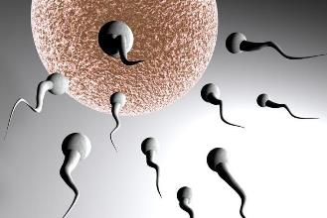
Sperm Mobility
2 percentages to assess
Number of sperm that are moving
    Should be at least 40%
Number of sperm that are swimming forward
    Should be at least 32%
http://www.abc.net.au/news/2015-10-24/sperm-swimming-towards-an-egg/6881998

Slide 22
Cause of Poor Motility
Same as poor sperm count
As well as:
  Zinc deficiency
  Defects in the tails
  Longer length of time between ejaculation
Great research showing lifestyle and diet can improve sperm motility

Slide 23

Acetyl-l-carnitine (ALCAR)
ALCAR is found in the highest concentration in the epididymis and plays a major role in the energy metabolism and maturation of spermatozoa (Mongioi, 2016)
L-carnitine deficiency can reduce fatty acid concentrations within the mitochondria and lead concerns with sperm motility (Mongioi, 2016)
A positive correlation between free L-carnitine and both sperm count and sperm motility has been established in a study involving 124 infertile patients (Menchini-Fabris GF et al, 1984)
20 patients with oligoasthenozoospermia were treated with 4 g/day of ALCAR for 60 days.
60% of the patients had increase in the progressive sperm motility - 4 months after therapy discontinuation sperm return to pretreament baseline.(Moncada et al, 1992)

Slide 24
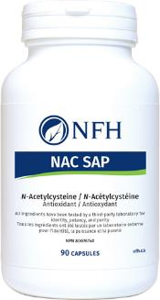
N-Acetyl cysteine (NAC)
NAC functions as an antioxidant by serving as a precursor of glutathione peroxidase. (Safarinejad et al, 2009)
2 studies, looked at NAC and sperm parameters at 600 mg/day for 26 weeks (Safarinejad et al, 2009) and 13 weeks (Ciftci et al, 2009)
Both studies demonstrated an improvement in sperm motility, however only one study observed an increase in sperm concentration and morphology (Safarinejad et al, 2009)

Slide 25
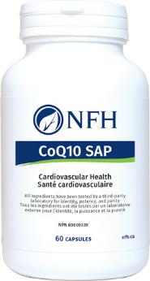
CoQ10
CoQ10 is a potent antioxidant needed from cellular respiration
In a double-blind study, CoQ10 at 200 mg/day in 60 men with idiopathic asthenoteratozoospermia for 6 months improved sperm motility and 12 spontaneous pregnancies occurred (Balercia et al, 2009)
Another study in 228 infertile men with 28 wk CoQ10 treatment showed improvement in sperm count, motility and morphology (Safarinejad et al, 2012)
Similarly, many other studies corroborate the beneficial effects of CoQ10 in improving sperm parameters (Lafuente et al, 2013)

Slide 26
Folate and B12
Vitamin B12 needed for cellular replication, RNA and DNA synthesis
Lower B12 status have been associated with decreased sperm count and motility (Ahmadi et al, 2016)
Methylcobalamin (1,500 mcg/day) supplementation in infertile men for a period of 8-60 weeks resulted in significant improvement in sperm parameters (Ahmadi et al, 2016)
A separate study found vitamin B12 (1000 mcg/day) given for lower sperm count saw profound benefit at the end of therapy (Sandler et al, 1984)
Abnormal folate metabolism is an important factor contributing to male infertility (Murphy et al, 2011)
Presence of MTHFR C677T, contributing male infertility- DNA fragmentation (Cornet et al 2017)

Slide 27
Vitamin C & E
Vitamin C is a water-soluble antioxidant
Found in high concentrations in seminal plasma (Ahmadi et al, 2016)
Vitamin C alone and in combination with other antioxidants has been shown to improve sperm quality and reduce DNA damage (Ahmadi et al, 2016)
Vitamin E is a fat-soluble antioxidant
Oral vitamin E supplementation has been shown to significantly decrease levels of lipid peroxidation in seminal plasma and improve sperm motility (Sinclair et al, 2000)
Selenium with vitamin E has been shown to significantly increase sperm motility and overall percentage of normal spermatozoa. (Sinclair, 2000)

Slide 28
Selenium and Zinc
Selenium:
  Vital trace element in testosterone biosynthesis and sperm formation and structural integrity of sperm (Keskes-Ammar et al, 2003)
  Se improves sperm count, concentration, motility and morphology in infertile men, especially in combination with N-acetyl-cysteine and vitamin E (Keskes-Ammar et al, 2003)
Zinc:
  Crucial for normal male reproductive system function (Ahmadi et al, 2016)
  Zinc deficiency is related to lower testosterone levels and sperm count as zinc is essential for proper sperm motility and production (Ahmadi et al, 2016 and Sinclair et al, 2000)
  Zinc supplementation studies at 24 and 89 mg of elemental zinc, showed increase in testosterone levels and sperm count along with successful pregnancies (Sinclair et al, 2000)

Slide 29
Lifestyle and Sperm
Marijuana use more than once per week was associated with a 28% lower sperm concentration and a 29% lower total sperm count after adjustment for confounders.
Combined use of marijuana more than once per week and other recreational drugs reduced the sperm concentration by 52% and total sperm count by 55% (Gundersen et al, 2015)
Alcohol intake and cigarette smoking are the major lifestyle factors with negative impact on fertility
Study looked at oxidative stress (OS), enzymatic antioxidant activity (EAO) of spermatozoa and on its DNA damage
108 male infertile patients with normal range of sperm conventional parameters but with unexplained infertility
4 groups: control (nonalcoholic and nonsmoker patients), alcohol group, smoking group and alcohol-smoking group
3 last groups compared to control had increased OS and DNA damage higher in the smoking and alcohol-smoking group (group also had highest values of DNA fragmentation)
Smoking and alcohol intake lead to unbalanced antioxidant/oxidation ratio with high OS leading to sperm DNA damage (Aboulmaouahib et al, 2017)

Slide 30
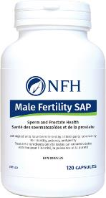
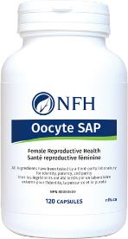
NFH- Fertility focused products
MALE FERTILITY SAP
ACTIVE INGREDIENTS
Each non-GMO vegetable capsule contains:
N-Acetyl L-Carnitine -250 mg
N-Acetyl-L-Cysteine-125 mg
Vitamin C-125 mg
PQ10 (emulsified coenzyme Q10)-75 mg
Mixed tocopherols (from non-GMO soy)- 25 mg
Selenium -50 mcg
Zinc citrate) - 2.5 mg
Chromium Picolinate- 62.5 mcg
Vitamin B12 (Methylcobalamin) -250mcg
Folate (from Calcium L-5-Methyltetrahydrofolate)-200 mcg
OOCYTE SAP
ACTIVE INGREDIENTS
Each non-GMO vegetable capsule contains:
PQ10 (emulsified coenzyme Q10- 50 mg
Acetyl L-Carnitine Hydrochloride -125 mg
N-Acetyl-L-Cysteine- 125 mg
R-alpha-Lipoic acid- 50 mg
myo-Inositol-250 mg
Mixed tocopherols
concentrate -25 mg
Vitamin C- 50 mg

Slide 31

LET'S MAKE THE NEXT GENERATION THE HEALTHIEST
With the vast amount of research focused on improving the health of both oocyte and sperm it is critical for us as naturopathic doctors to educate our patients pre-conceptually on optimizing health for their babies

Slide 32
References
Abdelrazik, H., et al., L-carnitine decreases DNA damage and improves the in vitro blastocyte development rate in mouse embryos. Fertil Steril. 2009. 91(2): 589-96
Aboulmaouahib, S et al. Impact of alcohol and cigarette smoking consumption in male fertility potential: Looks at lipid peroxidation, enzymatic antioxidant activities and sperm DNA damage. Andrologia 2017 Nov 21. doi: 10.1111/and.12926. [Epub ahead of print]
Ahmadi S, et al. Antioxidant supplements and semen parameters: An evidence based review. Int J Reprod Biomed (Yazd). 2016;14(12):729-736.
Ames, B.N., and J. Liu. “Delaying the mitochondrial decay of aging with acetylcarnitine.” Annals of the New York Academy of Sciences. Vol. 1033 (2004): 108–116.
Artini, PG., et al., Endocrine and clinical effects of myo-inositol administration in polycystic ovary syndrome. Gynecol Endocrinol. 2013. 29(4): 375-9
Balercia G., et al. Coenzyme Q 10 treatment in infertile men with idiopathic asthenozoospermia: a placebo-controlled, double-blind randomized trial. Fertil Steril 2009; 91: 1785-1792.
Barim-Oz, O., et al., The influence of dietary antioxidant on ovarian eggs and levels of vitamin E, C, A, astaxanthin, β- carotene and oxidative stress in tissues of Astacus leptodactylus (Eschscholtz) during reproduction. Cell Mol Biol (Noisy-le-grand). 2016. 62(14): 1-10.
Benkhalifa M, Ferreira YJ, Chahii H, Louanjli N,Miron P, Merviel P, et al. Mitochondria: Participation to infertility as source of energy and cause of senescence. The International Journal of Biochemistry & Cell Biology. 2014;55:60–4.
Chiu T, Rogers M, Law E, Briton-Jones C, Cheung L, Haines C. Follicular ﬂuid and serum concentrations of myo-inositol in patients undergoing IVF: relationship with oocyte quality. Human Reproduction. 2002;17(6):1591-1596
Ciftci, H., et al. Effects of N-acetylcysteine on semen parameters and oxidative/antioxidant status. Urology 2009; 74, 73–76.
Cornet, D., et al. Association between the MTHFR-C677T isoform and structure of sperm DNA. J Assist Reprod Genet (2017) 34:1283–1288
ESHRE Guideline: management of women with premature ovarian insuﬃciency. Human Reproduction. 2016;31(5):926–37.
Facchine F., et,al., Results from the International Consensus Conference on Myo-inositol and d-chiro-inositol in Obstetrics and Gynecology: the link between metabolic syndrome and PCOS. European Journal of Obstetrics & Gynecology and Reproductive Biology. 2015;195:72-76.
Fenkci, SM., et al., Serum total L-carnitine levels in non-obese women with polycystic ovary syndrome. Hum Reprod. 2008. 23(7): 1602-6
Genazzani, AD., et al., Modulatory effects of alpha-lipoic acid (ALA) administration on insulin sensitivity in obese PCOS patients. J Endocrinol Invest. 2017. doi: 10.1007/s40618-017-0782-z.
Gulcin, I., et al., Antioxidant and antiradocal activities of L-carnitine. Life Sci. 2006. 78(8): 803-11
Gundersen TD, et al. Association Between Use of Marijuana and Male Reproductive Hormones and Semen Quality: A Study Among 1,215 Healthy Young Men. Am J Epidemiol. 2015 Sep 15;182(6):473-81
Ismail, AM., et al., Adding L-carnitine to clomiphene resistant PCOS women improves the quality of ovulation and the pregnancy rate. A randomized clinical trial. Eur J Obstet Gynecol Reprod Biol. 2014. 180: 148-52
Kathirvel, E., et al. “Acetyl-l‑carnitine and lipoic acid improve mitochondrial abnormalities and serum levels of liver enzymes in a mouse model of nonalcoholic fatty liver disease.” Nutrition Research. Vol. 33, No. 11 (2013): 932–941.
Keskes-Ammar L., et al. Sperm oxidative stress and the effect of an oral vitamin E and selenium supplement on semen quality in infertile men. Arch Androl 2003; 49: 83-94.
Lafuente R., et al. Coenzyme Q10 and male infertility: a meta-analysis. J Assis Reprod Gen 2013; 30: 1147-1156.

Slide 33
References
Meldrum DR, Casper F, Diez-Juan A, Simon C, Domar AD, Frydman R. Aging and the environment aﬀect gamete and embryo potential: can we intervene? Fertility and Sterility. 2016;105(3):548–59.
Menchini-Fabris GF., et al. Free L-carnitine in human semen: its variability in different andrologic pathologies. Fertil Steril 1984;42:263-267.
Moncada ML., et al. Effect of acetylcarnitine treatment in oligoasthenospermic patients. Acta Eur Fertil 1992; 23, 221–224.
Mongioi L. The role of carnitine in male infertility. Andrology. 2016 Sep;4(5):800-7.
Murphy LE, et al. Folate and vitamin B12 in idiopathic male infertility. Asian J Androl. 2011 Nov;13(6):856-61.
Pacchiarotti, A., et al., Effect of myo-inositol and melatonin versus myo-inositol, in a randomized controlled trial, for improving in vitro fertilization of patients with polycystic ovarian syndrome. Gynecol Endocrinol. 2016. 32(1): 69-73
Pal L, Jindal S, WiS BR, Santoro N. Less is more... Increased gonadotropin use for ovarian stimulation adversely inﬂuences clinical pregnancy and live birth following IVF. Fertility Sterility 2008; 89:1694–701.
Rahmani, E., et al., The effect of coenzyme Q10 supplementation on gene expression related to insulin, lipid and inflammation in patients with polycystic ovary syndrome. Gynecol Endocrinol. 2017. 26: 1-6
Rago, R., et al., Effect of myo-inositol and alpha-lipoic acid on oocyte quality in polycystic ovary syndrome non-obese women undergoing in vitro fertilization: a pilot study. J Biol Regul Homeost Agents. 2015. 29(4): 913-23
Refaeey, A., et al., Combined coenzyme Q10 and clomiphene citrate for ovulation in clomiphene-citrate-resistant polycystic ovary sydrome. Reprod Biomed Online. 2014. 29(1): 119-24
Rossi BV, Berry KF, Hornstein MD, Cramer DW, Ehrlich S, Missmer SA. Eﬀect of alcohol consumption on in vitro fertilization. Obstet Gynecol. 2011;117:136–42.
Ruder, EH., et al., Female dietary antioxidant intake and time to pregnancy among couples treated for unexplained infertility. Fertil Steril. 2014. 101(3): 759-66
Safarinejad, M.R., and Safarinejad, S. Efficacy of selenium and/ or N-acetyl-cysteine for improving semen parameters in infertile men: a double-blind, placebo controlled, randomized study. J. Urol. 2009; 181, 741–751.
Safarinejad MR., et al. Effects of the reduced form of coenzyme Q 10 (ubiquinol) on semen parameters in men with idiopathic infertility: a double-blind, placebo controlled, randomized study. J Urol 2012; 188: 526-531.
Sandler B., and B. Faragher. Treatment of oligospermia with vitamin B-12. Infertility 1984; 7:133-138.
Seko L, Moroni R, Leitao V, Teixeira D, Nastri C, Martins W. Melatonin supplementation during controlled ovarian stimulation for women undergoing assisted reproductive technology: systematic review and meta-analysis of randomized controlled trials. Fertility and Sterility. 2014;101(1): 154-161.e4.
Sinclair S. Male infertility: nutritional and environmental considerations. Altern Med Rev. 2000 Feb;5(1):28-38.
Takasaki A, Tamura H, Miwa I, Taketani T, Shimamura K, Sugino N (April 2010). “Endometrial growth and uterine blood flow: a pilot study for improving endometrial thickness in the patients with a thin endometrium”. Fertil. Steril. 93 (6): 1851–8.
Tolstrup JS, Kjaer S, Holst C, Sharif H, Munk C, Osler M, et al. Alcohol use as predictor for infertility in a representative population of Danish women. Acta Obs Gynecol Scand.2003;82:744–9.
Wise L, Rothman K, Mikkelsen E, Sørensen H, Riis A, Hatch E. A prospective cohort study of physical activity and time to pregnancy. Fertility and Sterility. 2012;97(5):1136-1142.e4.
Wong, W.Y., et al. Effects of folic acid and zinc sulfate on male factor subfertility: a double-blind, randomized, placebo-controlled trial. Fertil. Steril. 2002, 77, 491–498.
Xu et al. Pretreatment with coenzyme Q10 improves ovarian response and embryo quality in low-prognosis young women with decreased ovarian reserve: a randomized controlled trial. Reproductive Biology and Endocrinology (2018) 16:29

Slide 34


Thank you !
Dr. Tori Hudson, ND

